Slide 1
Docker Fundamentals
Adnan Khan

Slide 2
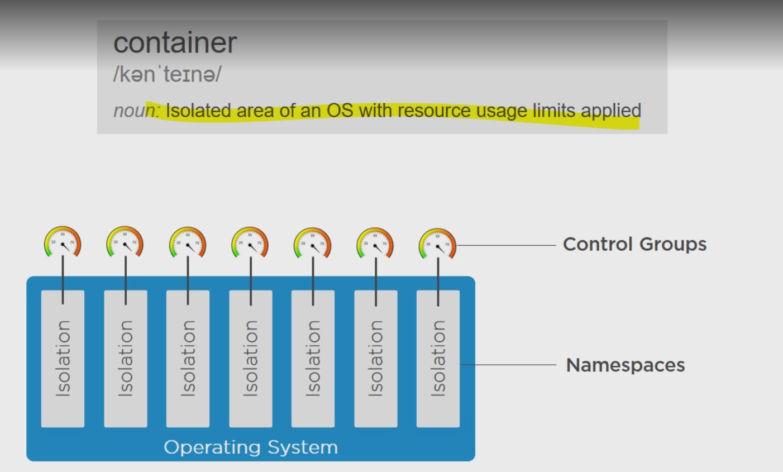
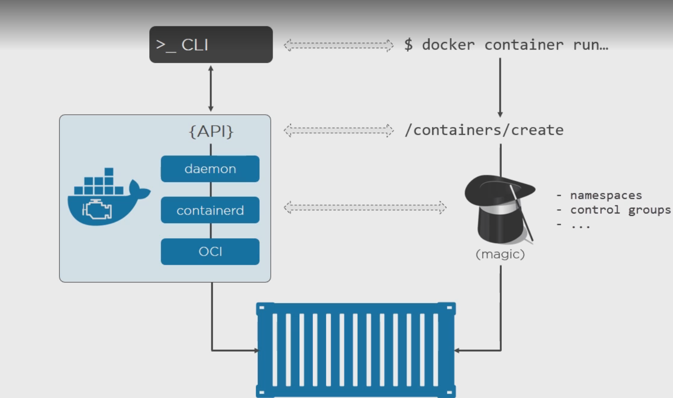
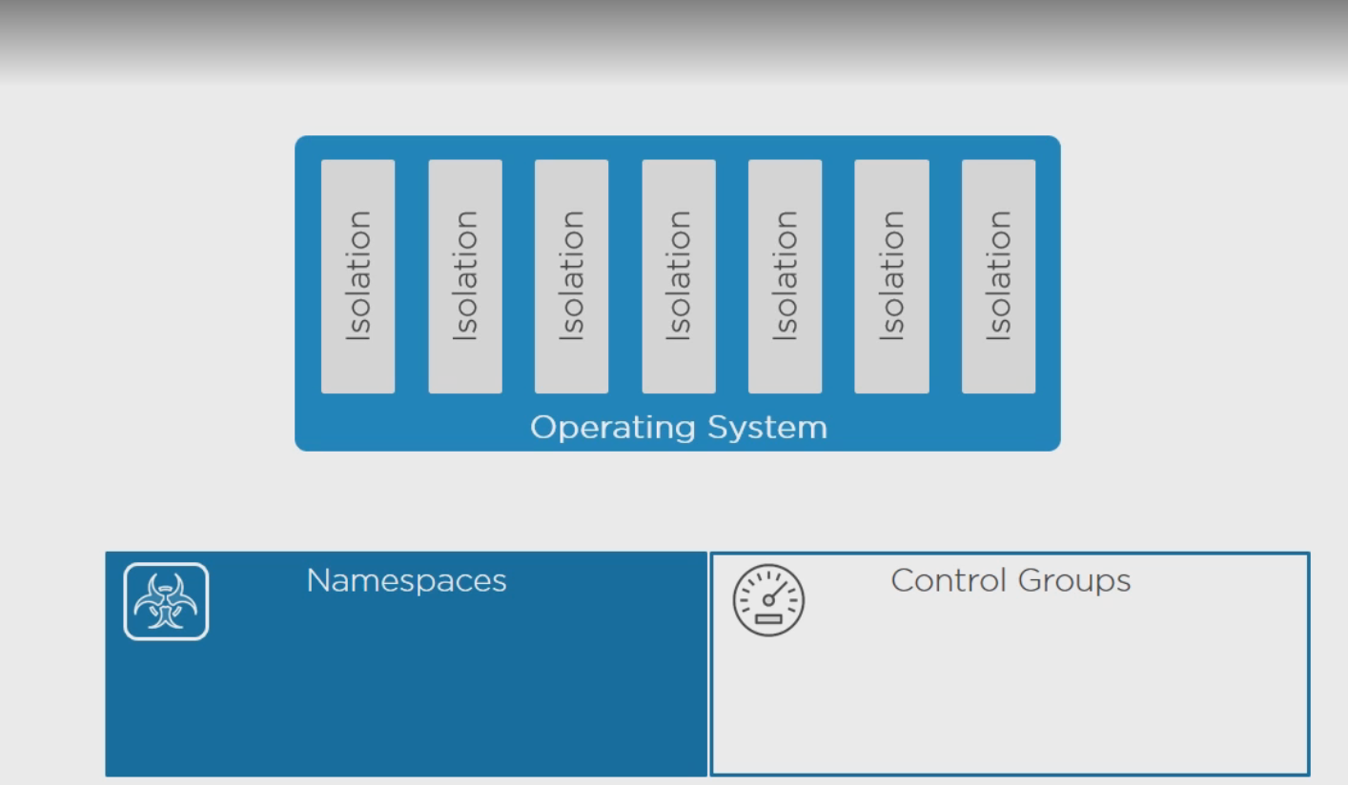
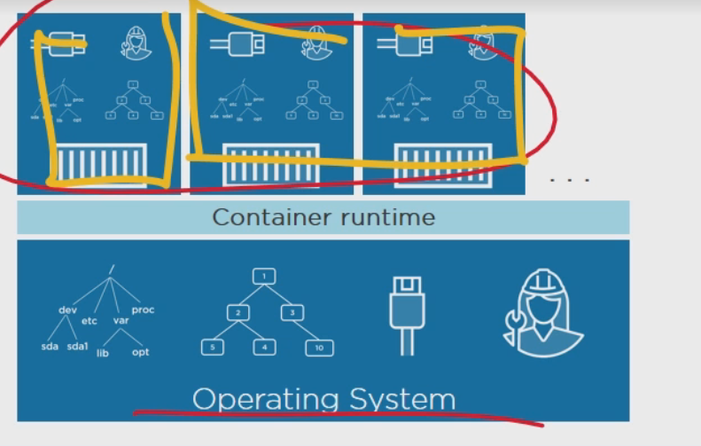
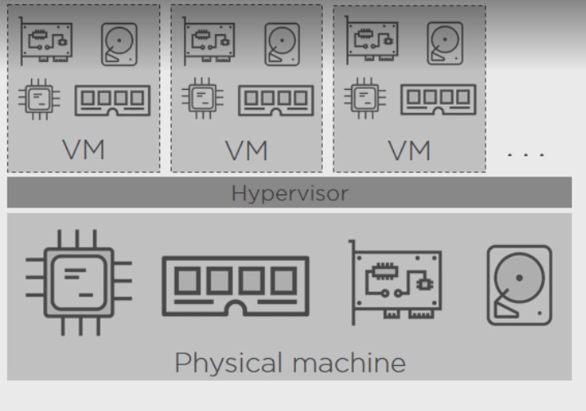
Docker Architecture

Slide 3
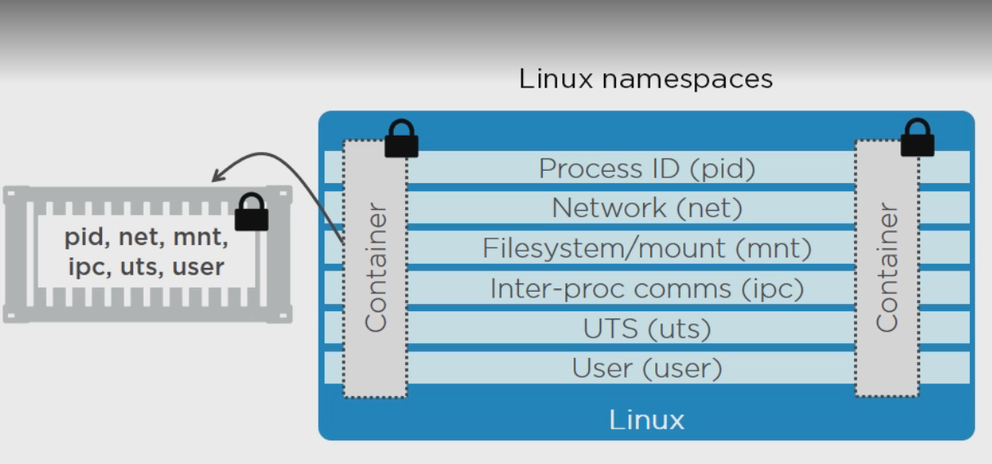
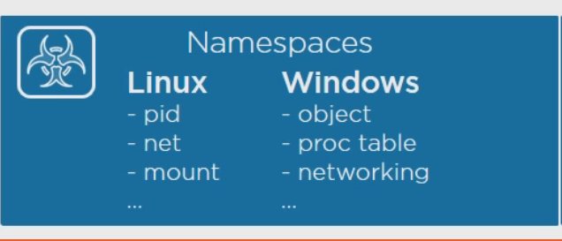
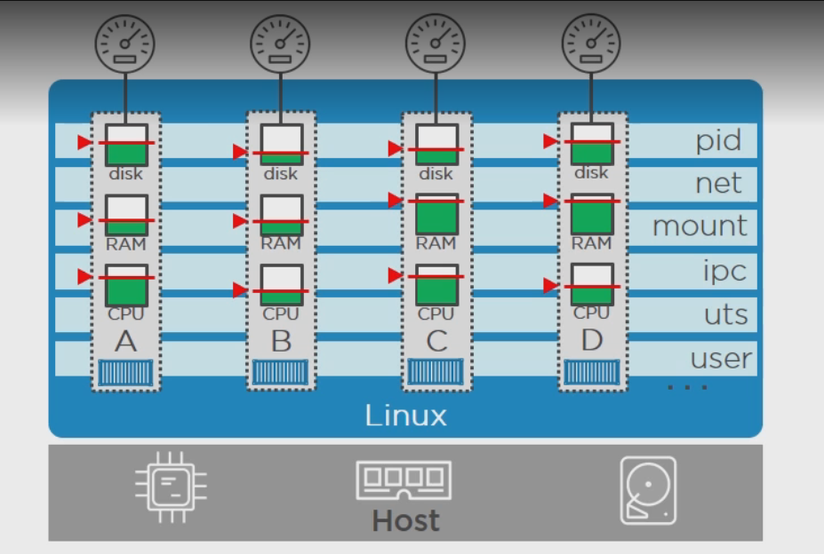
Docker Architecture Contd

Slide 4
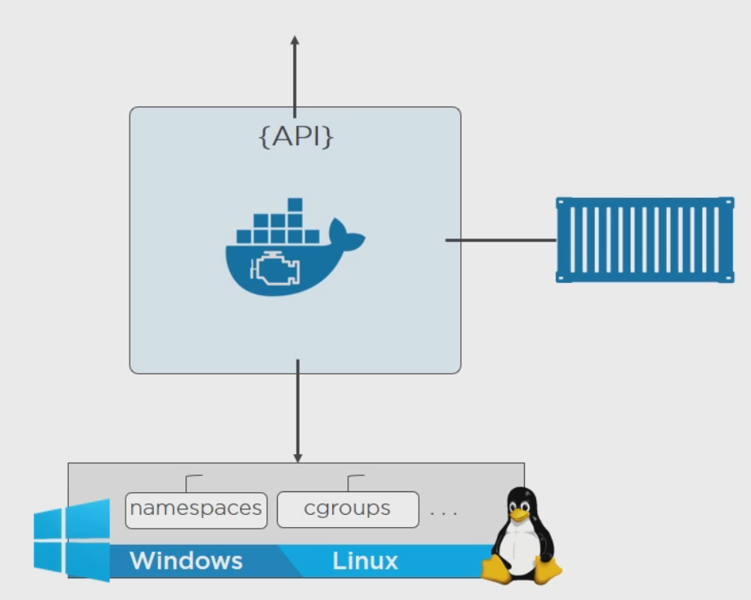
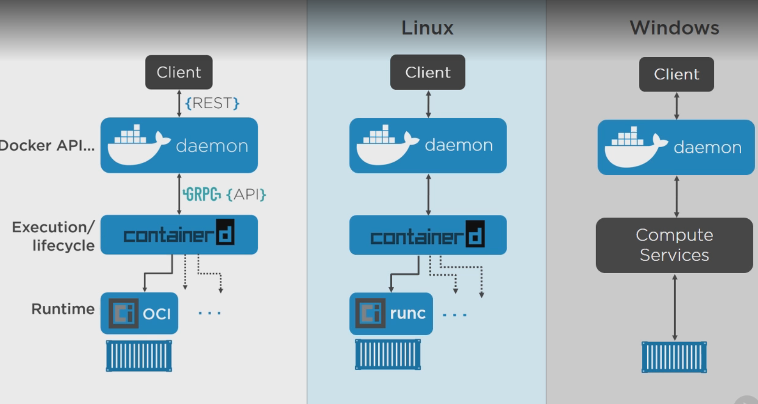
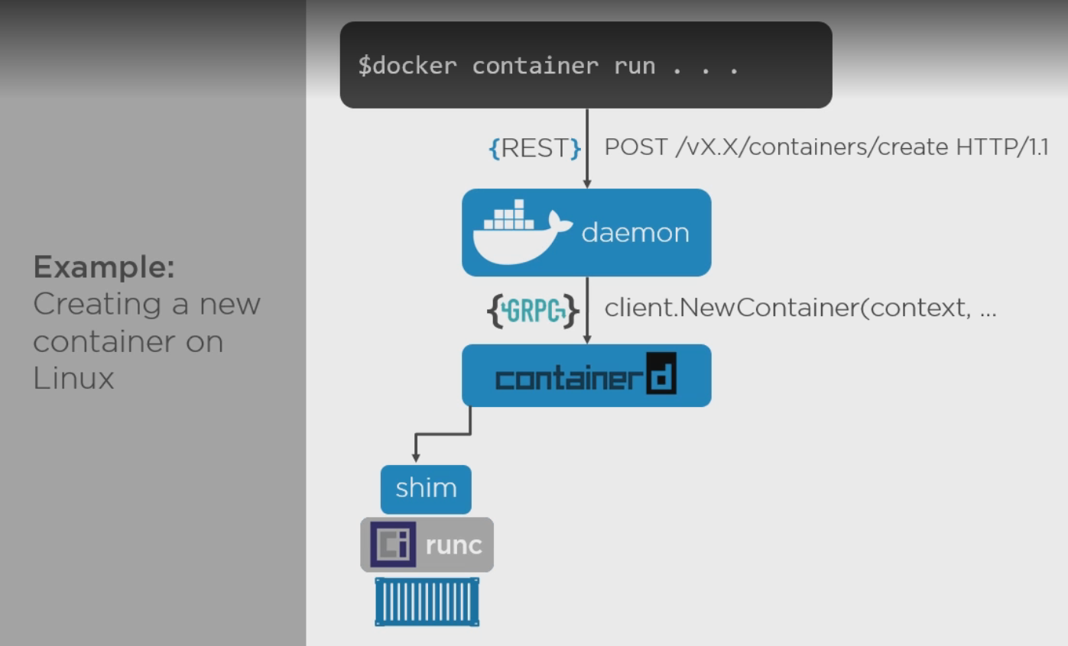

Slide 5
Docker Architecture Contd
Two Main Building Blocks are used when creating Containers:
NameSpaces: These are about Isolation.
These take up an operating system and help them split into multiple operating systems.
Control Groups:
Limit the resources to be used by Processes .
Help in achieving realistic containers on a machine.

Slide 6
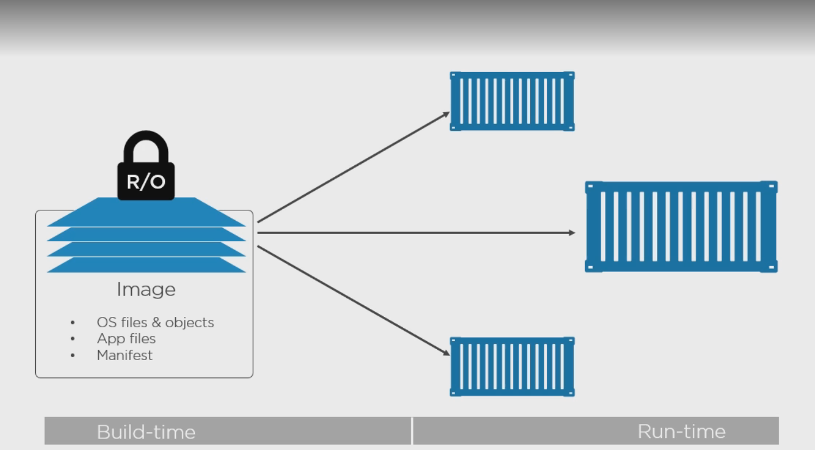
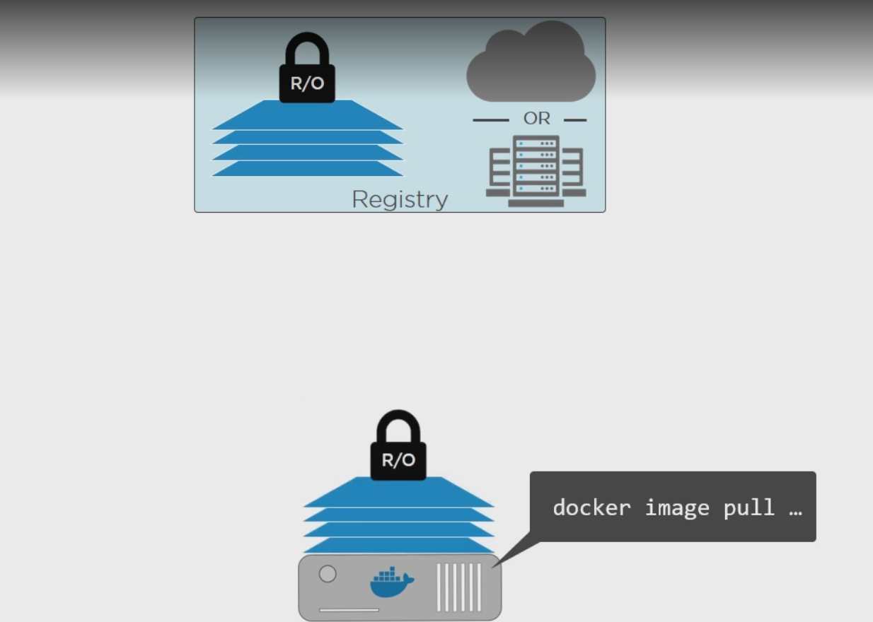
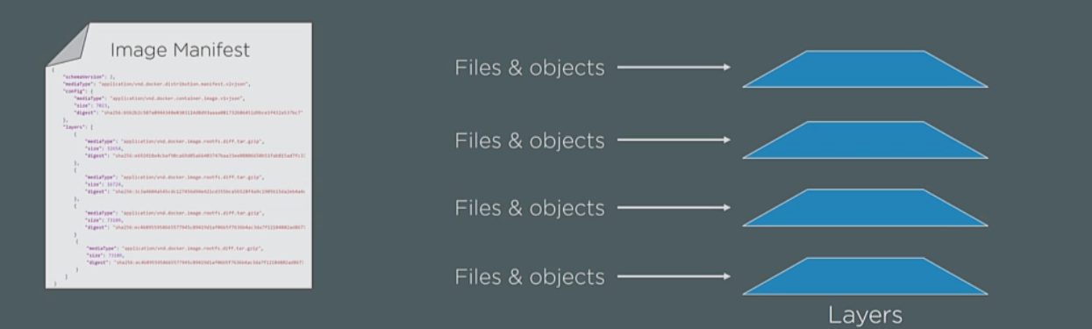
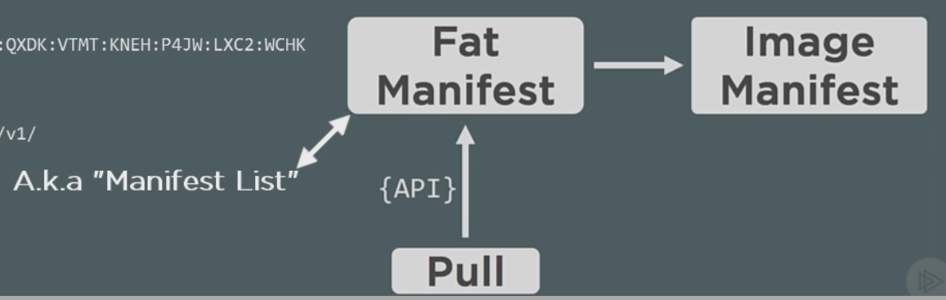
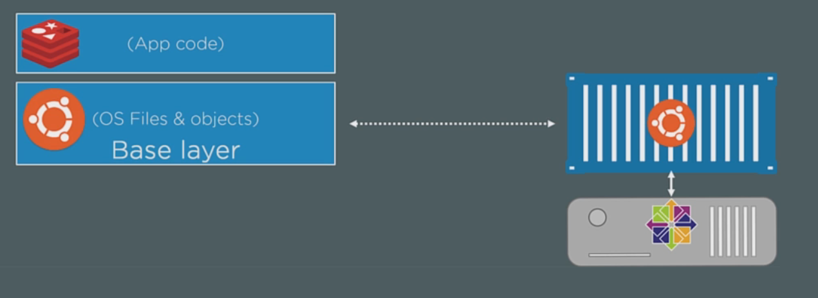
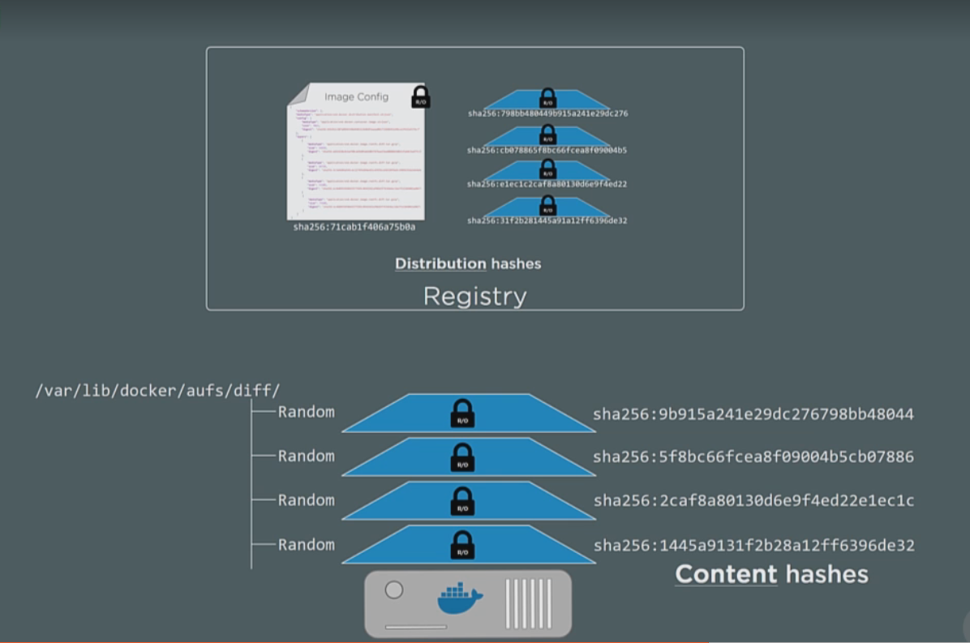
Images

Slide 7
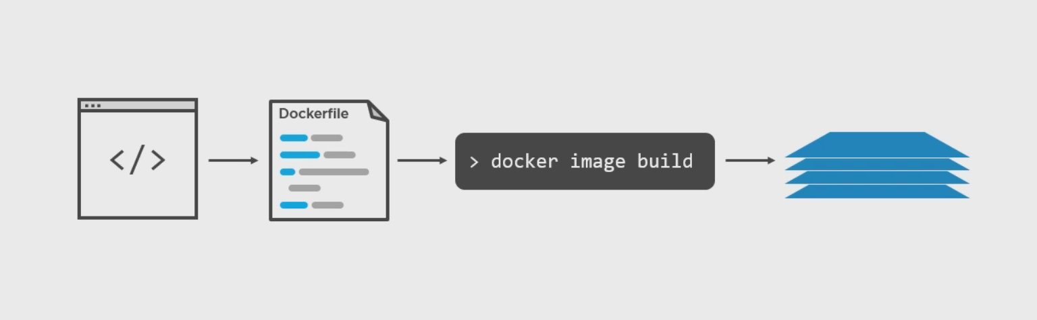
Building Images

Slide 8
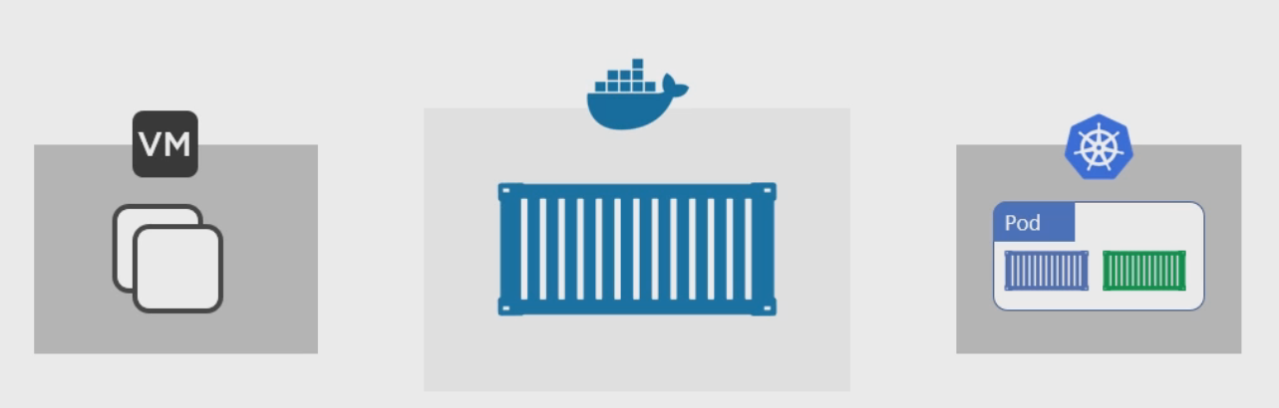
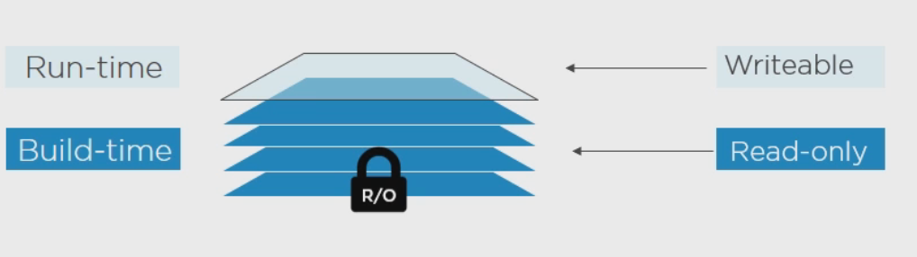
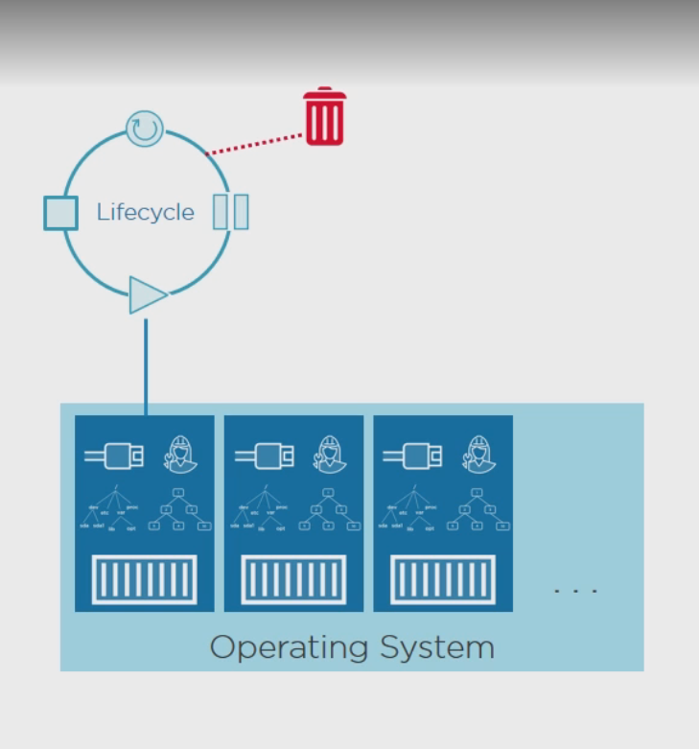
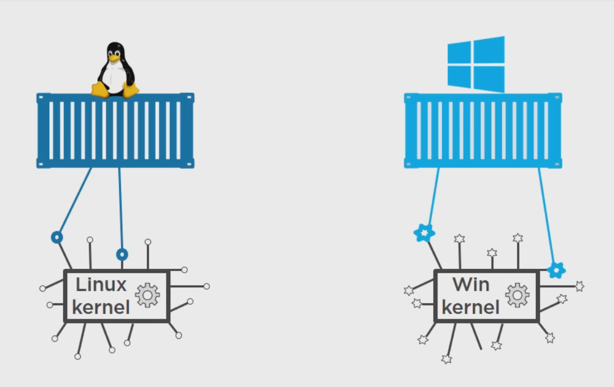
Containers:

Slide 9
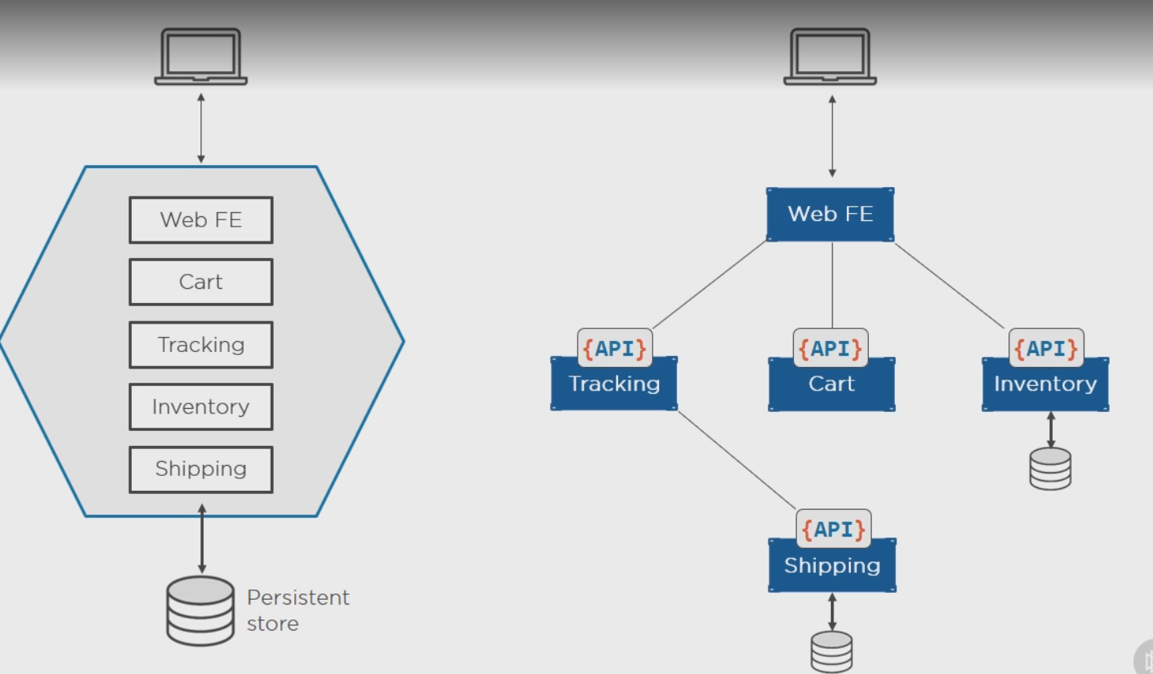
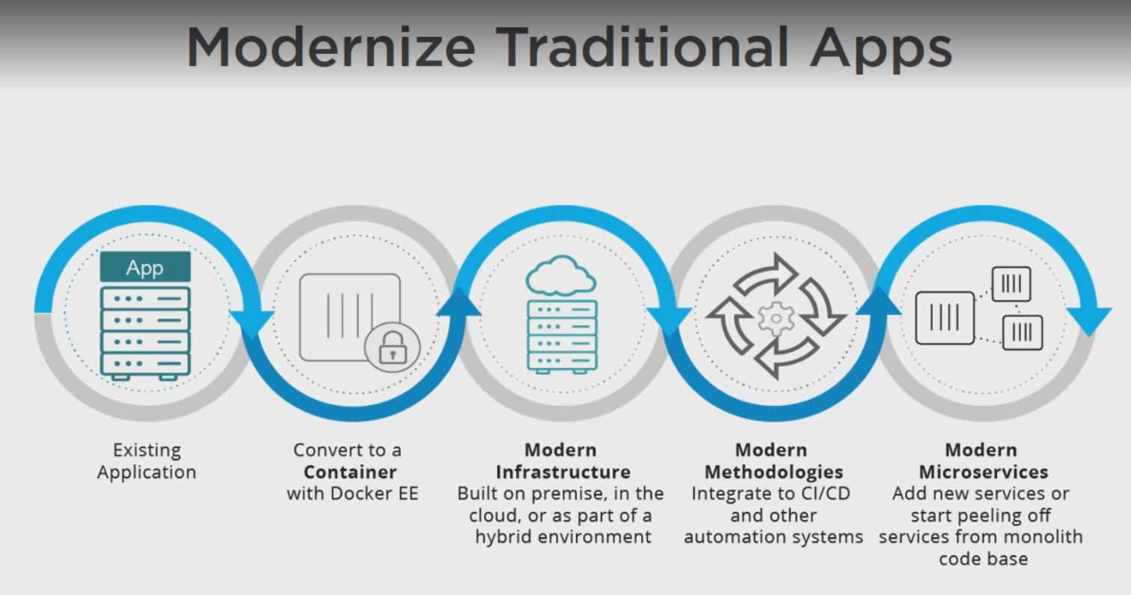
Containers and Apps

Slide 10
Docker Logging
Logs for docker engine
Journactl –u docker.service (systemd linux)
/var/log/messages (linux)
~/APPDATA/local/Docker (windows)
Docker Container Logs
If the app hosted in a container is launched as main process , the logs gets written to standard input and output and can be accessed via docker container logs.
In some cases, docker logs may not show useful information unless you take additional steps.
If you use a logging driver which sends logs to a file, an external host, a database, or another logging back-end, docker logs may not show useful information.
If your image runs a non-interactive process such as a web server or a database, that application may send its output to log files instead of STDOUT and STDERR
One of the ways to have log files direct out put to docker logs is to create symlink between files and standard input output.
# forward request and error logs to docker log collector
RUN ln -sf /dev/stdout /var/log/nginx/access.log \
&& ln -sf /dev/stderr /var/log/nginx/error.log
In case of logger plugins, the plugins can be overwritten on container basis by –log-driver –log-opts flags.
More on logging drivers (https://docs.docker.com/config/containers/logging/configure/)

Slide 11
Docker Networking
Three Pillars of Docker Netwoking:
CNM(Container Network Model):
It is the DNA of docker networking.
Its is built on 3 main components
SandBox: A Sandbox contains the configuration of a container's network stack. This includes management of the container's interfaces, routing table and DNS settings. Sandbox may contain many endpoints from multiple networks.
EndPoint: An Endpoint joins a Sandbox to a Network. Endpoint can belong to only one network and it can belong to only one Sandbox, if connected.
Network: Is a group of Endpoints that are able to communicate with each-other directly. An implementation of a Network could be a Linux bridge, a VLAN, etc. Networks consist of many endpoints.
LibNetwork:
Drivers:

Slide 12
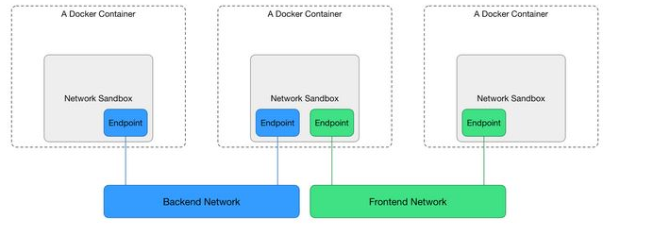
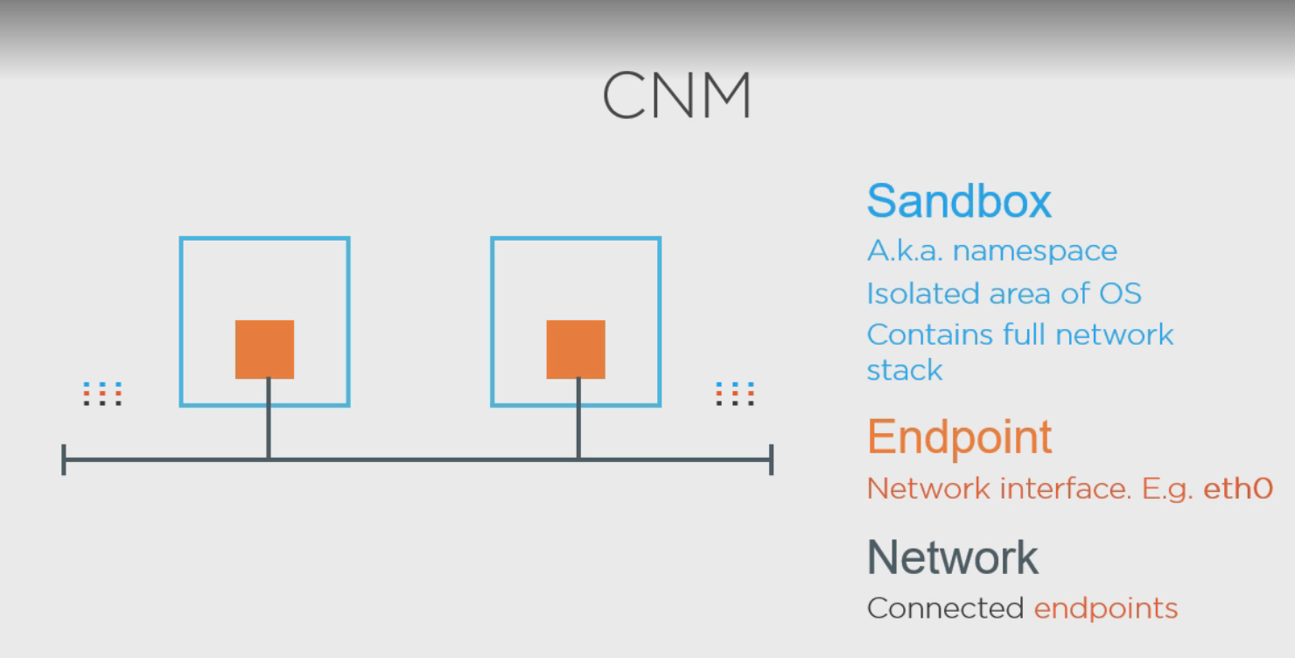
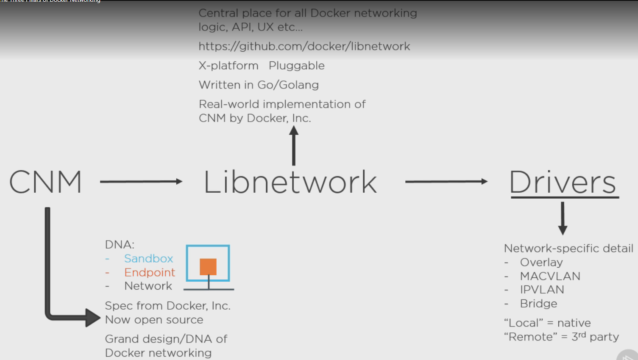
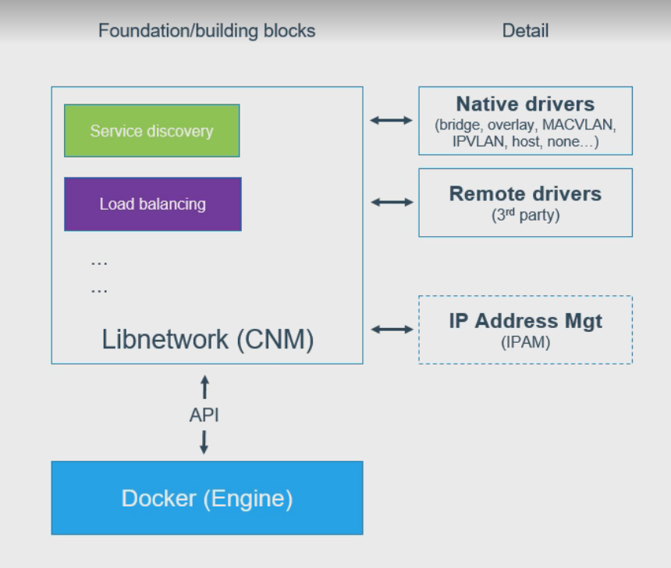
CNM
Drivers
N/W controller
Network
Endpoints
Container

Slide 13
Single Host Networking

Slide 14
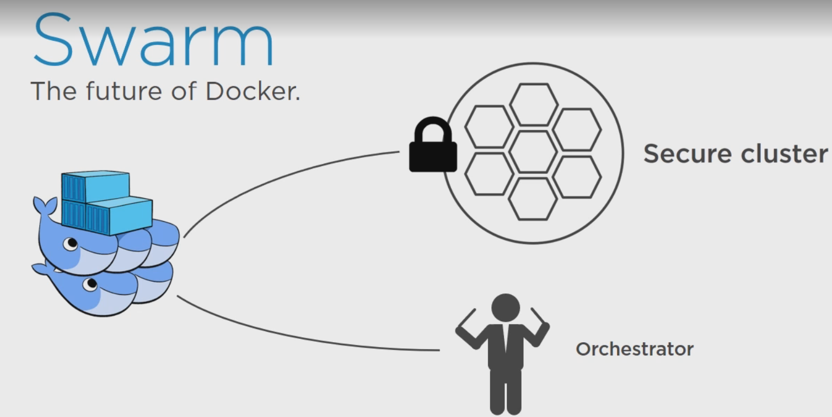
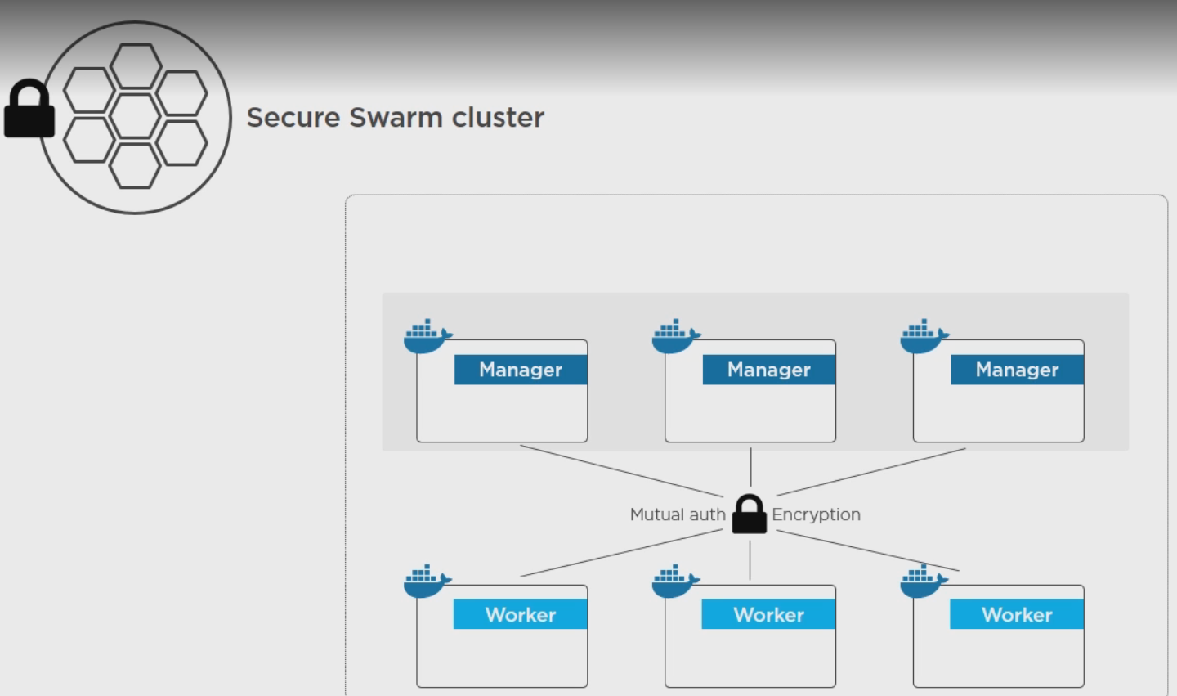
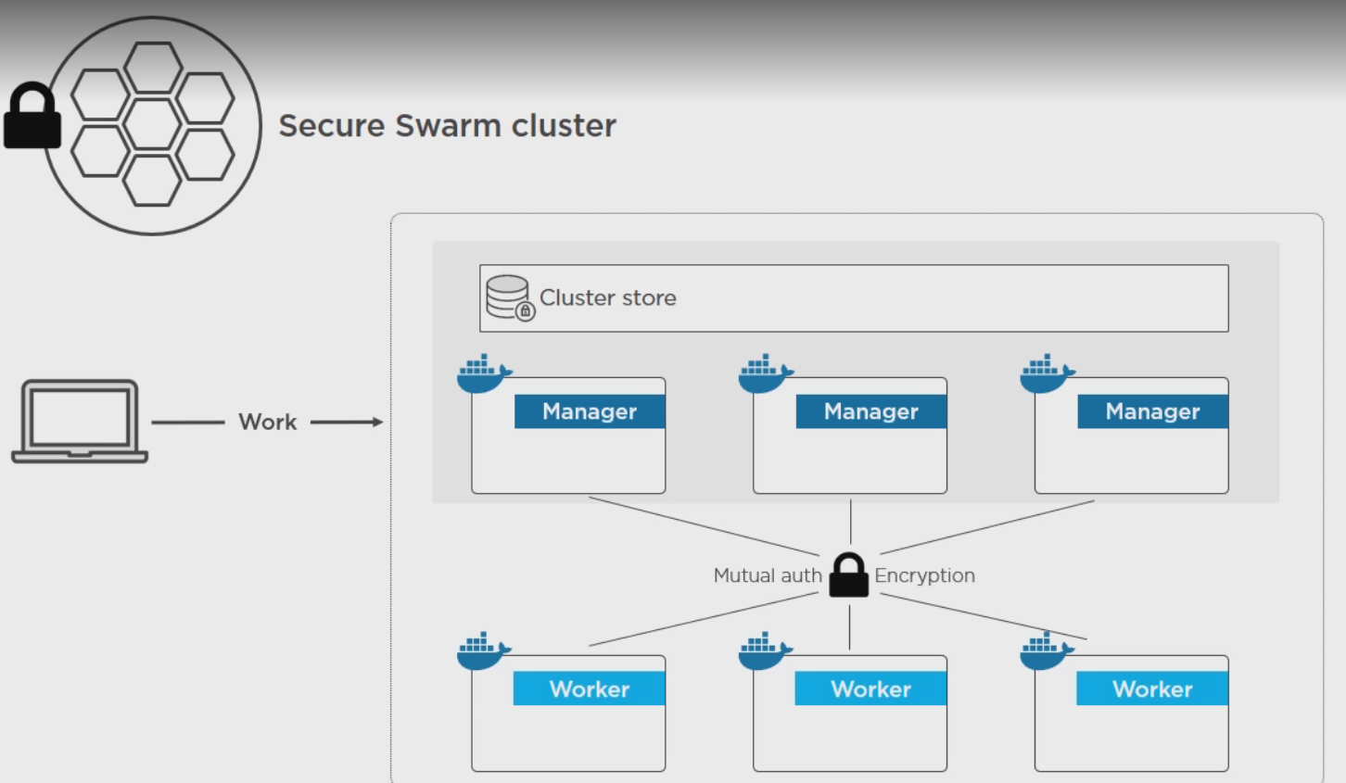
Docker Swarm

Slide 15
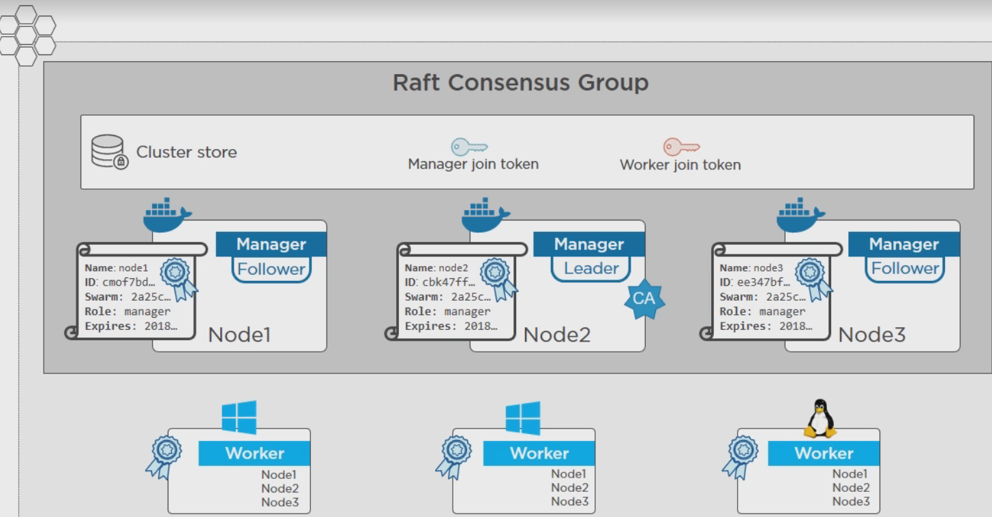
Swarm
To initiate the swarm mode , run docker swarm init. , upon swarm init, the first machine to it on is marked as Manager and the leader in swarm.
It creates a etcd storage and generates CA certificates for authentication.
It generates tokens for joining new manager and new worker.
To join a node or manager into swarm cluster, using docker swarm join <join_token_for_node_or_manager>

Slide 16
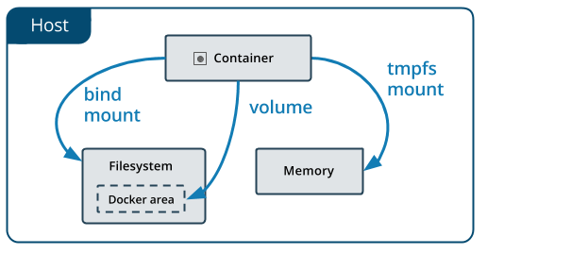
Data Storage in Docker
The data doesn’t persist when that container no longer exists, and it can be difficult to get the data out of the container if another process needs it.
A container’s writable layer is tightly coupled to the host machine where the container is running. You can’t easily move the data somewhere else.
Writing into a container’s writable layer requires a storage driver to manage the filesystem. The storage driver provides a union filesystem, using the Linux kernel. This extra abstraction reduces performance as compared to using data volumes, which write directly to the host filesystem.
Docker has two options for containers to store files in the host machine, so that the files are persisted even after the container stops: volumes, and bind mounts.
Volumes are stored in a part of the host filesystem which is managed by Docker (/var/lib/docker/volumes/ on Linux). Non-Docker processes should not modify this part of the filesystem. Volumes are the best way to persist data in Docker.
Bind mounts may be stored anywhere on the host system. They may even be important system files or directories. Non-Docker processes on the Docker host or a Docker container can modify them at any time.
tmpfs mounts are stored in the host system’s memory only, and are never written to the host system’s filesystem.
More information on storage is available at https://docs.docker.com/storage/ .

